Slide 1
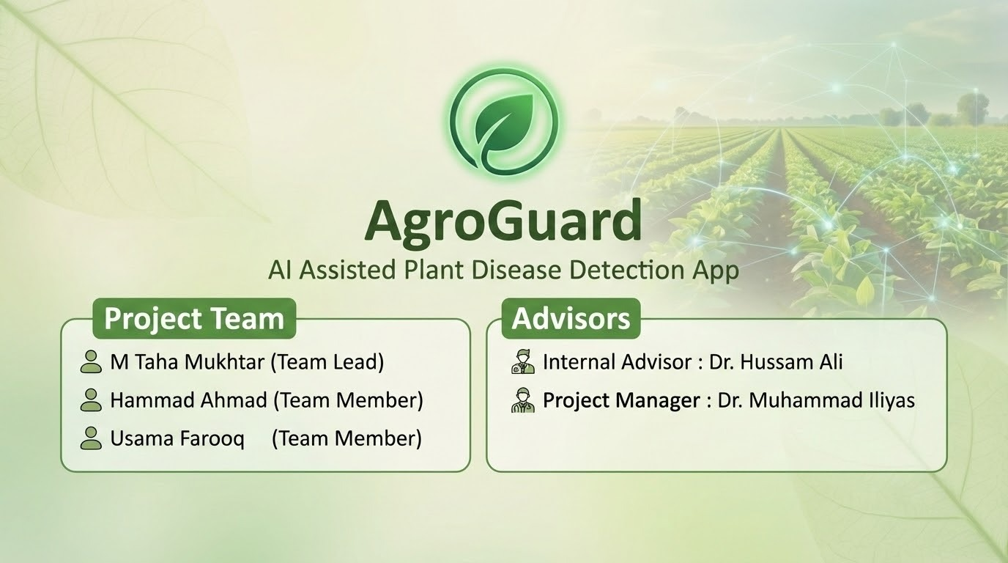

Slide 2
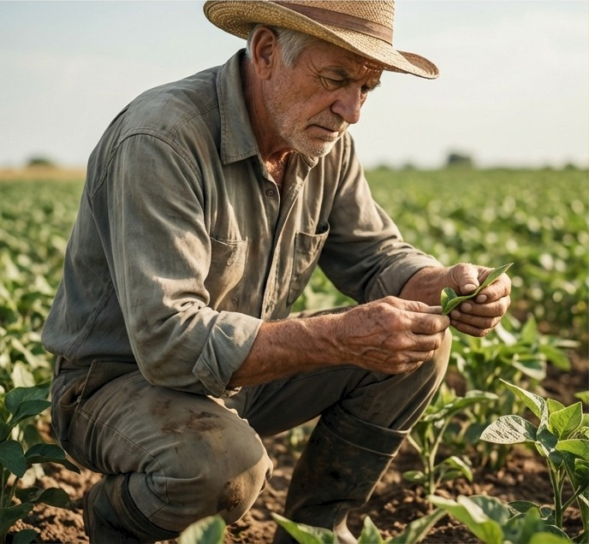



Bridging the Gap Between Agriculture and Technology
The Challenge
Agriculture is essential, but many farmers face persistent challenges, unpredictable weather, crop diseases, and limited access to timely expert advice. Most rely on traditional methods, leading to productivity issues and financial losses.
Our Mission
To develop a user-friendly, AI-powered Farmer Assistant app that makes advanced agricultural technology accessible to all farmers. Our system provides accurate, real-time insights in a single platform to help farmers make better decisions, boost productivity , and adapt to changing conditions.
Protection
AI Insights
Timely Advice

Slide 3





A Focused Scope for a Robust System
In Scope: Core Functionality
AI-Based Disease detection: Users can upload
or capture plant images for Al analysis.
Detailed Diagnostics: The system provides disease names, descriptions, symptoms, and causes.
Actionable Recommendations: Suggests suitable treatment options (both organic and chemical) and preventive measures.
Real-Time Weather Updates: Displays localized weather data (temperature, humidity, conditions) based on GPS.
AI Chatbot Assistant: An intelligent agent for farmers to ask questions about general agriculture and crop health.
Out of Scope: Future Considerations
Marketplace for agricultural products.
Advanced automation tools (e.g., drones). Automated irrigation or pest control systems. E-commerce or payment gateway integration.
Real-time community or chat features.

Slide 4
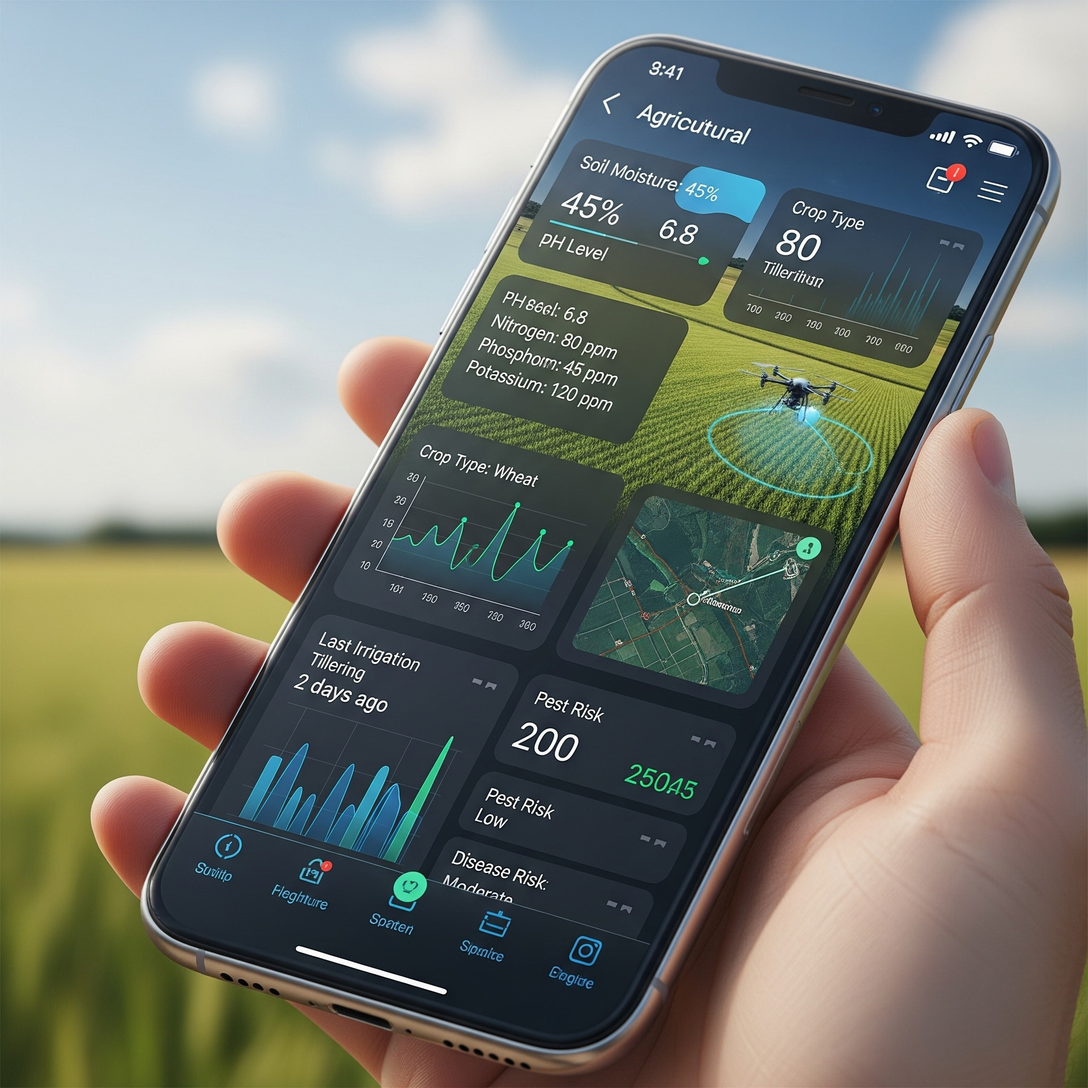
External Interface Requirements
The application requires Android 8.0 or later versions.
Minimum device specifications include 2 GB of system RAM.
A minimum of 100 MB of free storage space is necessary.
Rear camera resolution must be at least 8 MP for image capture.
Internet connectivity is mandatory for data synchronization and AI analysis.

Slide 5
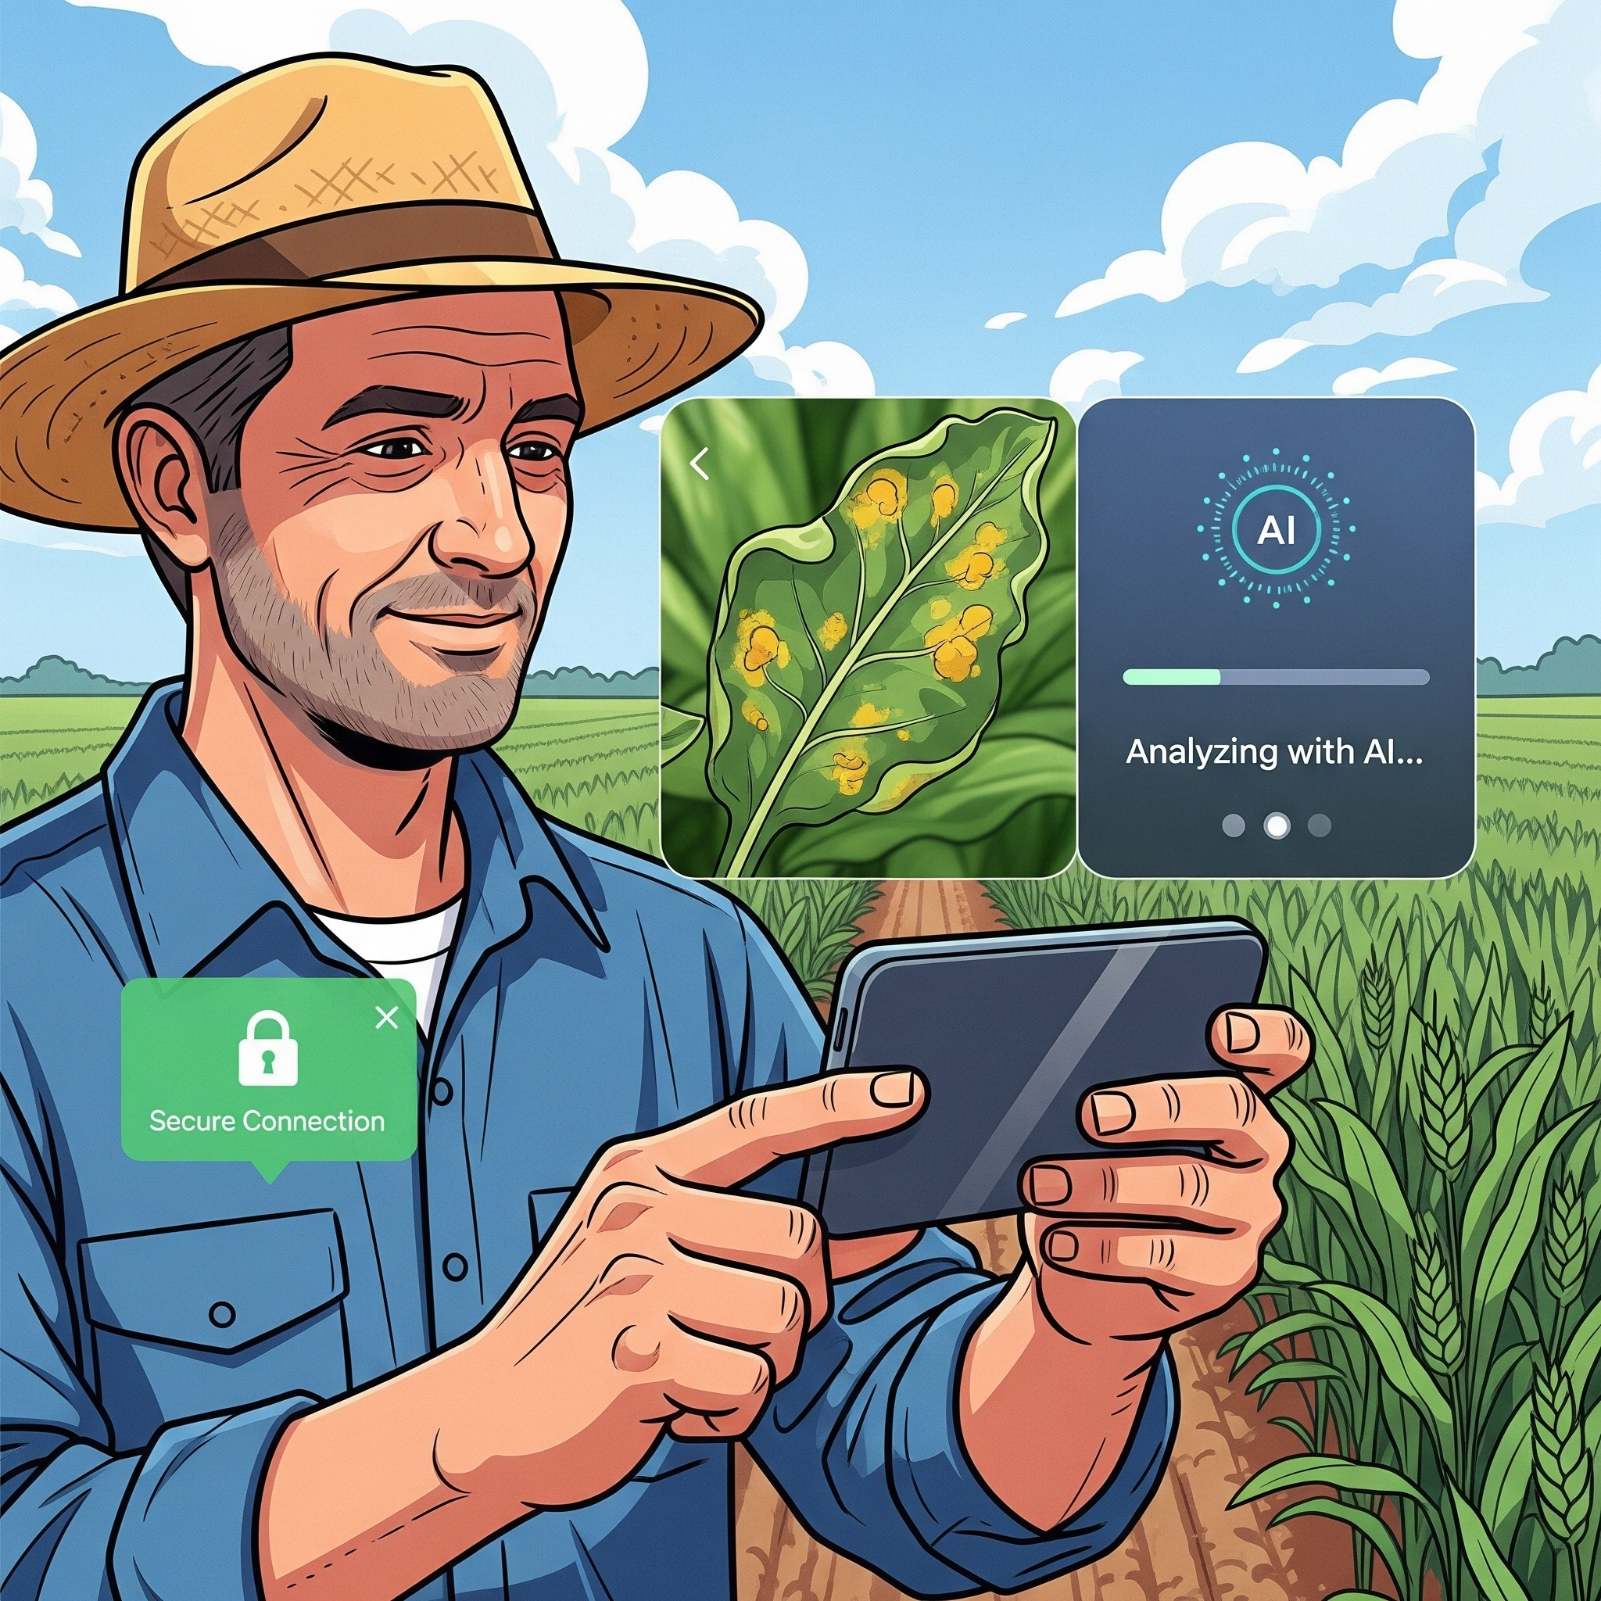
Functional Requirements
Users must register and securely log into the application
The system must use AI to detect plant diseases
Display disease details and treatment recommendations
Provide real-time localized weather information to users
Users can interact with the AI chatbot for queries

Slide 6
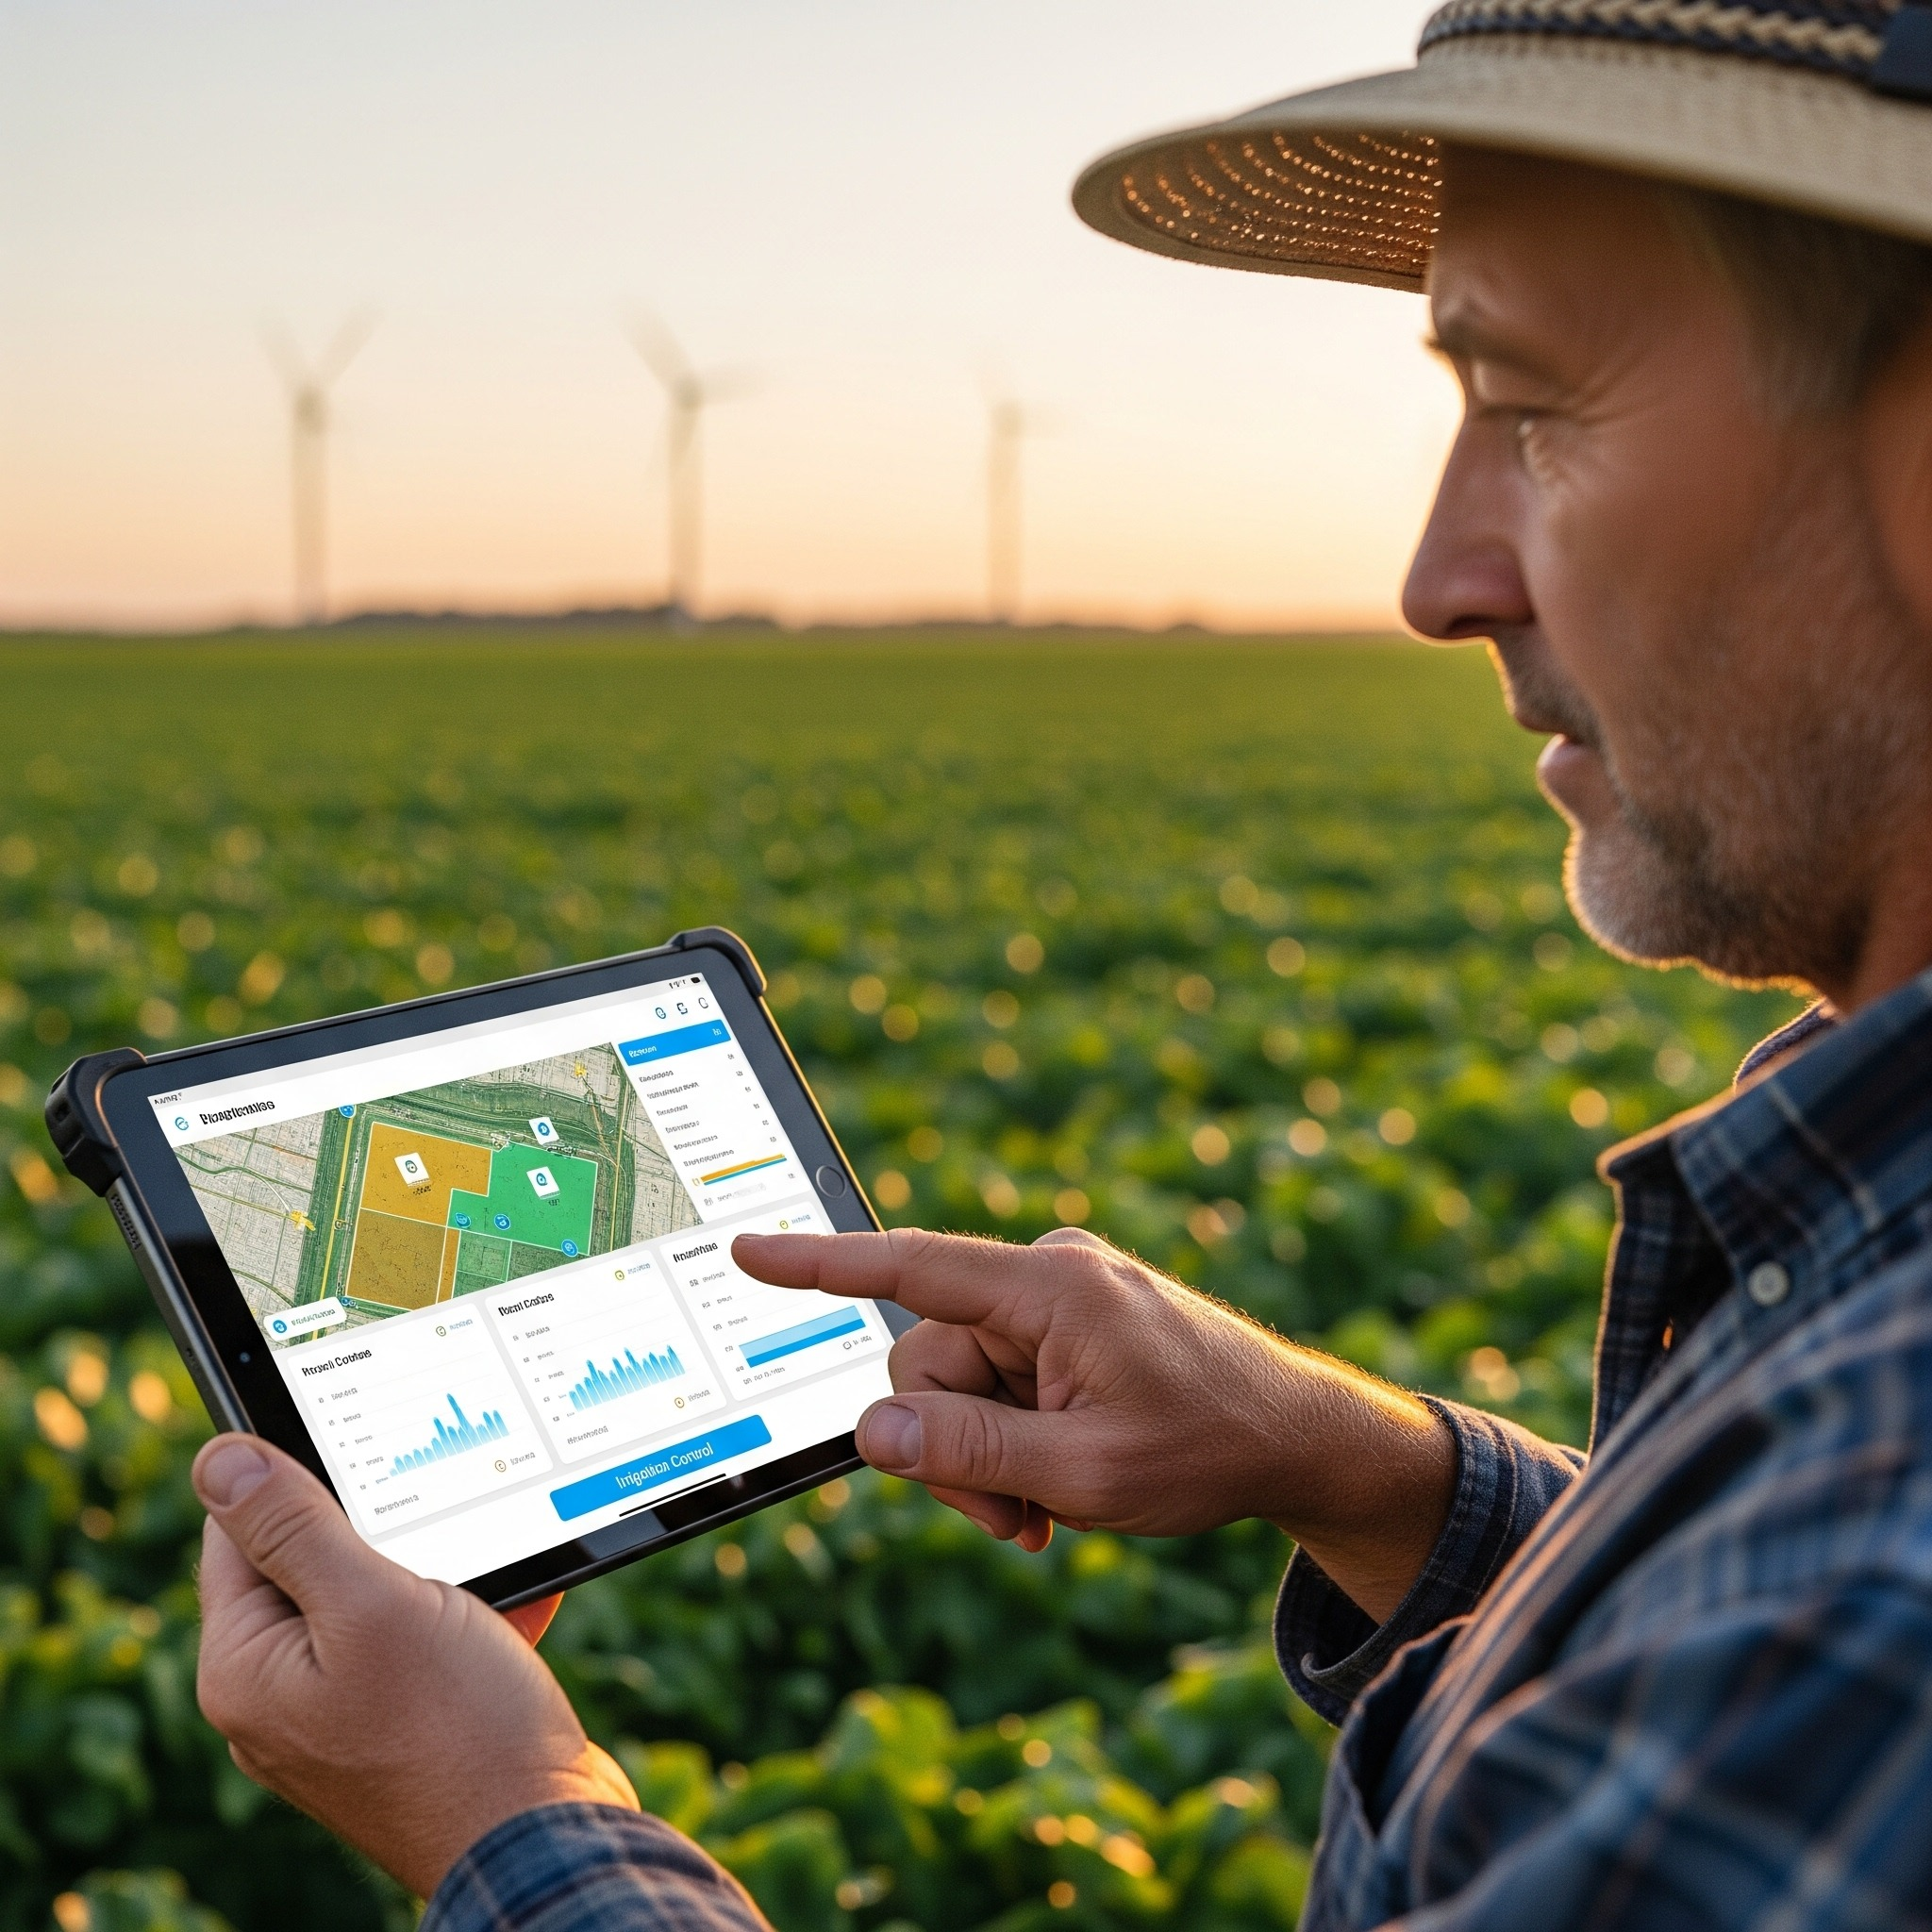
Non-Functional Requirements
Diagnosis results must be returned quickly to the farmer.
The system utilizes a simple user interface for easy adoption.
Secure authentication and data storage are managed by Firebase.
Cloud-based architecture ensures scalability for a growing user base.
The system handles external API failures with graceful error handling.

Slide 7






A Modern Tech Stack Built on Proven Technologies
Mobile Client (Native Android)
Language: Kotlin
UI Toolkit Jetpack Compose
Backend Cloud Services
Platform: Firebase (Authentication, Firestore,
Storage)
API Integration
ML inference: Cloud-based via an API on a server.
Networking: Retrofit for all non-Firebase API calls
Why?
Native coderuns faster than bridged solutions, especially for image processing. Camera provides stable hardware control, and Jetpack Compose offers a modern, declarative, and type-safe UI toolkit.
Why?
Reduces backend boilerplate, offers seamless integration with security rules, and provides Firestore Offline Persistence, allowing the app to write to a local cache first and sync automatically when connectivity is restored.
Why?
Cloud-based inference on a dedicated GPU server ensures high-accuracy predictions without overburdening the user's device. Retrofit is the industry standard for type-safe HTTP communication on Android.

Slide 8
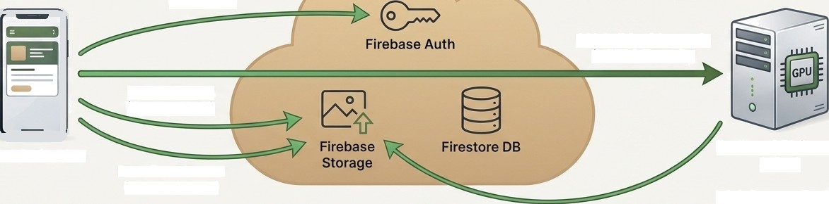
The AgroGuard Ecosystem: A High-Level
Deployment Architecture
Authenticate User (Auth SDK)
API Call for Diagnosis (HTTPS/Retrofit)
Upload Image (Storage SDK)
Android Device
Python API Server (GPU)
Data Persistence (Firestore SDK)
ML Inference Engine
Google Cloud / Firebase (Serverless Platform)
Fetch Image
for Analysis

Slide 9






A Foundation of Clean Architecture for Separation of Concerns
UI Layer (View)
LoginScreen
CameraScreen
ResultScreen
Observes state and captures user actions. Built with Jetpack Compose.
Key Takeaway
This architecture ensures a clear separation of concerns, making the system highly testable, easier to debug, and scalable for future feature additions.
Presentation Layer (ViewModel)
AuthViewModel
DetectionViewModel
Manages UI-related state, executes Use Cases, exposes state via ”StateFlow”.
Data Layer (Repository)
AuthRepository
DiseaseRepository
Single source of truth. Mediates between remote and local data sources.
Data Sources
Remote (Firebase/Retrofit)
Local (Room/DataStore)

Slide 10



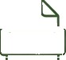


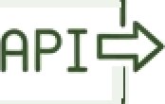
The Journey of a Diagnosis: From Image
Capture to Insightful Result
(JSON)
1
Capture
User captures or uploads a plant image via the Android app.
2
Upload
The app compresses the image (JPEG, quality 80) and uploads it securely to Firebase Storage.
3
Request
The app sends the image URL to the Python API backend via a Retrofit POST request.
4
Analyze
The backend API server retrieves the image and runs it through the pre-trained Deep Neural Network model to perform classification.
5
Respond
The API returns the diagnosis results (disease name, confidence score, description, treatment) in JSON format.
6
Display
The Android app parses the response and displays the formatted results and recommendations to the user on the ' ResultScreen*.
All image processing and network operations run asynchronously on background threads using Kotlin Coroutines to ensure a smooth,
non-blocking user interface.

Slide 11







Powering Predictions: The Machine Learning Engine Workflow
Image Acquisition
Gathering images of Healthy and diseased plants.
Leaf Image Dataset
Assembling the raw data.
Pre-Processing
Standarizing images (resizing, normalization)
Dataset Division
Splitting data into Test and Train sets.
Deep Neural Network Training
Iteratively training the model using the training set and validating with a validation subset..
Performance Assessment
Evaluating the trained model’s accuracy against the unseen test set.
Plant Leaf Disease Classification
The final, deployed model ready for inference.
.

Slide 12
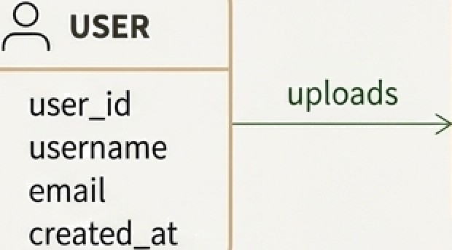



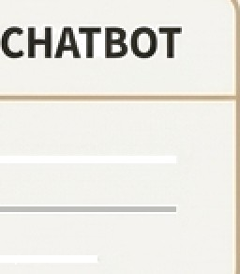
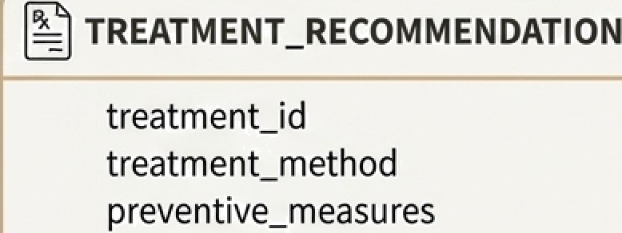
Structuring the System's Knowledge: A Logical Data Model
PLANT_IMAGE
DISEASE_DETECTION
image_id file path upload_time
is analyzed in
detection_id disease name confidence_score description
interacts with
Inc
udes

Slide 13
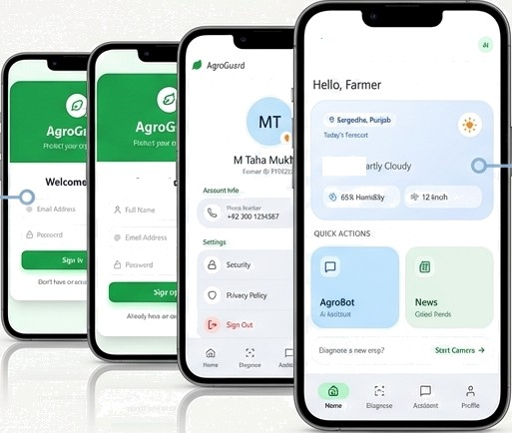
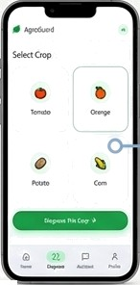
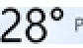
From Code to Experience: A Clean
and Intuitive User Interface
Simple and secure authentication powered by Firebase.
Streamlined crop selection for targeted diagnosis.
Create
At-a-glance dashboard with localized weather.
Design Philosophy: The UI, built with Jetpack Compose, is designed to be simple, reliable, and helpful for all users, including those with minimal experience.

Slide 14
Building for Resilience: Proactive Risk Management
Risk 1: Model Performance Variability
Description:
Detection accuracy may vary based on image quality, lighting, and disease stage.
Risk 2: Model Size and Performance on Device
Description:
Large ML models can cause slow inference times and consume excessive storage.
Risk 3: External API
Dependency
Description:
The weather API service may experience downtime, rate limiting, or changes in terms.
Mitigation:
Implement in-app image quality checks, provide user guidelines for capturing effective photos, and display confidence scores with diagnosis results.
Mitigation:
Utilize cloud-based inference for heavy lifting. For future on-device models, we will use optimization techniques like quantization and model compression.
Mitigation:
Implement graceful error handling and cache weather data locally. The system is designed modularly to allow for easy switching between service providers if needed.

Slide 15
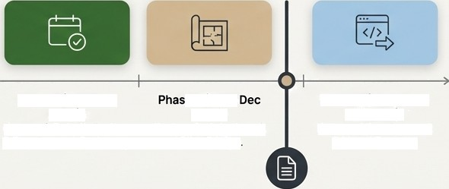

AgroGuard:
Capstone Project Overview
Project Summary
High-Level Project Timeline
• Core identity: “A robust, AI-powered agricultural assistant built on a modern, scalable, native Android
architecture."
Key Deliverables: A fully functional mobile application, a cloud-based ML inference engine, and comprehensive design documentation (SRS, SDS).
Phase 1 (Oct - Nov
2 0 2 5 )
Project Data Collection & Requirment Gathering.
e 2 (Nov -
2 0 2 5 ) :
System Architecture, UI/UXDesign
Phase 3 (Dec 2025 - Jan 2026):
Frontend Development
& Model Training.
Final Submission: December 15, 2025 (Design Document).

Slide 16
